Slide 1



Methods
Writing and using methods, overloads, ref, out
SoftUni Team
Technical Trainers
Software University
http://softuni.bg

Slide 2

Table of Contents
Using Methods
What is a Method? Why Use Methods?
Declaring and Creating Methods
Calling Methods
Methods with Parameters
Passing Parameters
Returning Values
Best Practices

Slide 3
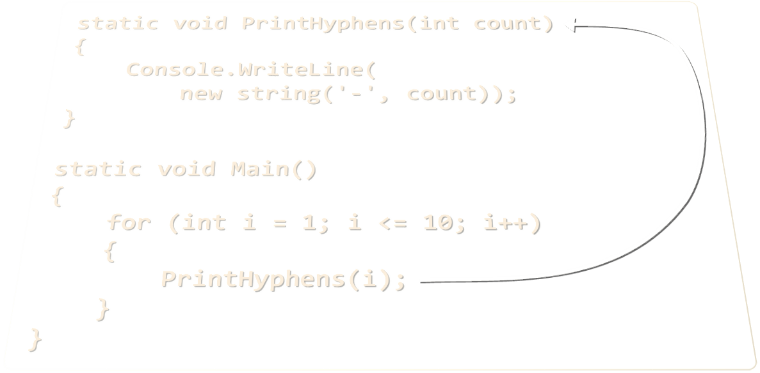
Methods
Declaring and Invoking Methods

Slide 4
Declaring Methods
A method is a named piece of code
Each method has:
Return type
Name
Parameters
static void PrintHyphens(int count)
{
Console.WriteLine(
new string('-', count));
}
Body

Slide 5
Invoking Methods
Methods can be invoked (called) by their name
static void PrintHyphens(int count)
{
Console.WriteLine(new string('-', count));
}
static void Main()
{
for (int i = 1; i <= 10; i++)
{
PrintHyphens(i);
}
}
Method body always surrounded by { }
Method called by name

Slide 6
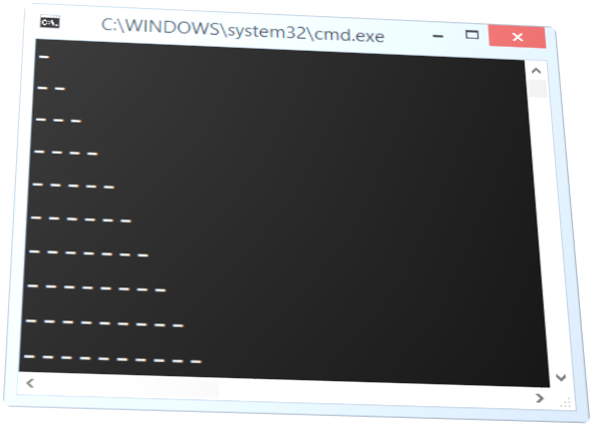
Methods
Live Demo

Slide 7
Method Parameters
Method parameters can be of any type
Separated by comma
static void PrintNumbers(int start, int end)
{
for (int i = start; i <= end; i++)
{
Console.Write("{0} ", i);
}
}
static void Main()
{
PrintNumbers(5, 10);
}
Declares the use of
int start and int end
Passed concrete values when called

Slide 8
Method Parameters – Example
static void PrintSign(int number)
{
if (number > 0)
Console.WriteLine("The number {0} is positive.", number);
else if (number < 0)
Console.WriteLine("The number {0} is negative.", number);
else
Console.WriteLine("The number {0} is zero.", number);
}
static void Main()
{
PrintSign(5);
PrintSign(-3);
PrintSign(0);
}

Slide 9
Optional Parameters
C# 4.0 supports optional parameters with default values:
The above method can be called in several ways:
static void PrintNumbers(int start = 0, int end = 100)
{
for (int i = start; i <= end; i++)
{
Console.Write("{0} ", i);
}
}
PrintNumbers(5, 10);
PrintNumbers(15);
PrintNumbers();
PrintNumbers(end: 40, start: 35);

Slide 10

Method Parameters
Live Demo

Slide 11
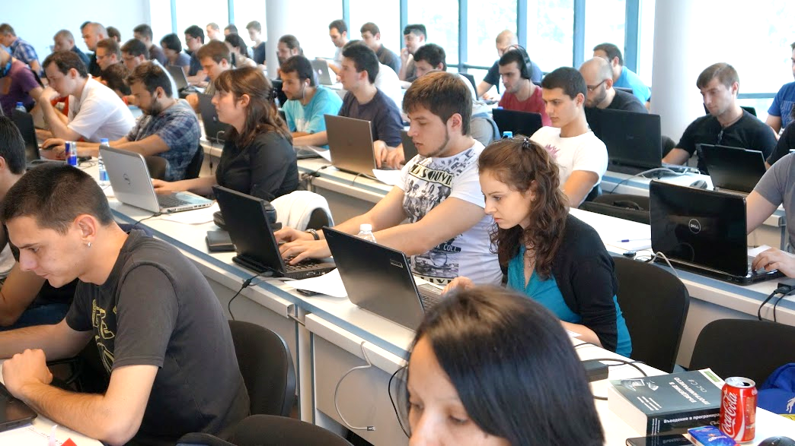
Exercises in Class

Slide 12
Printing Triangle
Create a method for printing triangles as shown below:
1
1 1 2
1 2 1 2 3
1 2 3 1 2 3 4
1 2 3 4 1 2 3 4 5
n=5 → 1 2 3 4 5 n=6 → 1 2 3 4 5 6
1 2 3 4 1 2 3 4 5
1 2 3 1 2 3 4
1 2 1 2 3
1 1 2
1

Slide 13
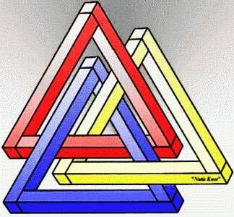
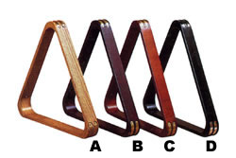
Printing Triangle
Live Demo

Slide 14

Returning Values From Methods

Slide 15
Method Return Types
Type void - does not return a value (only executes code)
Other types - return values, based on the return type of the method
static void AddOne(int n)
{
n += 1;
Console.WriteLine(n);
}
static int PlusOne(int n)
{
return n + 1;
}

Slide 16
Methods with Parameters and Return Value
static double CalcTriangleArea(double width, double height)
{
return width * height / 2;
}
static void Main()
{
Console.Write("Enter triangle width: ");
double width = double.Parse(Console.ReadLine());
Console.Write("Enter triangle height: ");
double height = double.Parse(Console.ReadLine());
Console.WriteLine(CalcTriangleArea(width, height));
}

Slide 17
Power Method
static double Power(double number, int power)
{
double result = 1;
for (int i = 0; i < power; i++)
{
result *= number;
}
return result;
}
static void Main()
{
double powerTwo = Power(5, 2);
Console.WriteLine(powerTwo);
double powerThree = Power(7.45, 3);
Console.WriteLine(powerThree);
}

Slide 18
Temperature Conversion – Example
Convert temperature from Fahrenheit to Celsius:
static double FahrenheitToCelsius(double degrees)
{
double celsius = (degrees - 32) * 5 / 9;
return celsius;
}
static void Main()
{
Console.Write("Temperature in Fahrenheit: ");
double t = Double.Parse(Console.ReadLine());
t = FahrenheitToCelsius(t);
Console.Write("Temperature in Celsius: {0}", t);
}

Slide 19

Returning Values From Methods
Live Demo

Slide 20

Overloading Methods
Multiple Methods with the Same Name

Slide 21
Overloading Methods
Method Overloading
Use the same method name for multiple methods with different signature (return type and parameters)
static void Print(string text)
{
Console.WriteLine(text);
}
static void Print(int number)
{
Console.WriteLine(number);
}
static void Print(string text, int number)
{
Console.WriteLine(text + ' ' + number);
}

Slide 22

Why Use Methods?
More manageable programming
Splits large problems into small pieces
Better organization of the program
Improves code readability
Improves code understandability
Avoiding repeating code
Improves code maintainability
Code reusability
Using existing methods several times

Slide 23
Methods – Best Practices
Each method should perform a single, well-defined task
Method's name should describe that task in a clear and non-ambiguous way
Good examples: CalculatePrice, ReadName
Bad examples: f, g1, Process
In C# methods should start with a capital letter (PascalCase)
Avoid methods longer than one screen
Split them to several shorter methods

Slide 24

Summary
Break large programs into simple
methods that solve small sub-problems
Methods consist of declaration and body
Methods are invoked by their name
Methods can accept parameters
Parameters take actual values when calling a method
Methods can return a value or nothing (void)

Slide 25










Methods
https://softuni.bg/courses/programming-basics/

Slide 26
License
This course (slides, examples, demos, videos, homework, etc.) is licensed under the "Creative Commons Attribution-NonCommercial-ShareAlike 4.0 International" license
Attribution: this work may contain portions from
"C# Fundamentals – Part 1" course by Telerik Academy under CC-BY-NC-SA license
"C# Fundamentals – Part 2" course by Telerik Academy under CC-BY-NC-SA license

Slide 27





Free Trainings @ Software University
Software University Foundation – softuni.org
Software University – High-Quality Education, Profession and Job for Software Developers
softuni.bg
Software University @ Facebook
facebook.com/SoftwareUniversity
Software University @ YouTube
youtube.com/SoftwareUniversity
Software University Forums – forum.softuni.bg

